Slide 1

How to solve the climate problem?
Richard S.J. Tol
University of Sussex
Vrije Universiteit Amsterdam

Slide 2
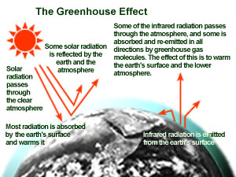

Slide 3
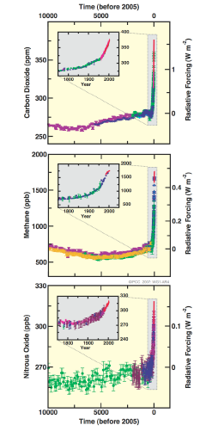

Slide 6
Emission reduction policy
Lower emissions are essentially about more efficient energy use and alternative energy sources
Incentive-based regulation is better suited for diffuse and heterogeneous emissions than rule-based regulation
Taxes are better suited for stock problems than tradable permits
Net present costs is lowest with a uniform carbon tax on all emissions from all sectors and all countries, rising with the interest rate

Slide 8
What’s all the fuss about?
Climate change is a relatively small problem, that is relatively easy to solve
Climate change is the new Armageddon
Climate policy allows politicians to grandstand while shifting the action to their successors
Climate policy allows bureaucrats to create new bureaucracies
Climate policy feeds the fears of conspiracy theorists
… and there is free-riding

Slide 9
A little game
Greenhouse gas emission reduction is a global good: The costs are private, the benefits are shared by everyone.
A rational, selfish actor would therefore reduce emissions by only a little, free-riding on other agents’ efforts
There is no solution to this, apart from installing a world government

Slide 10
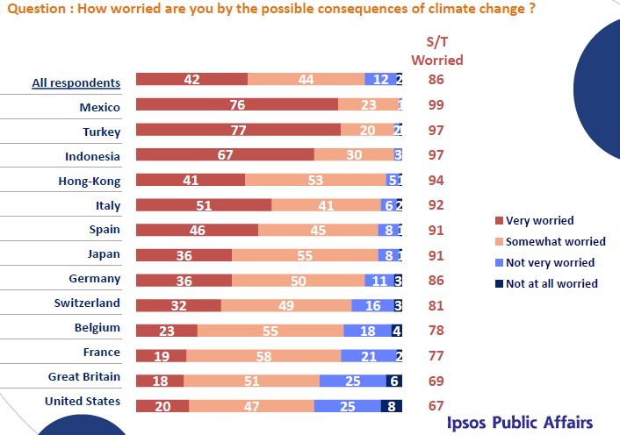
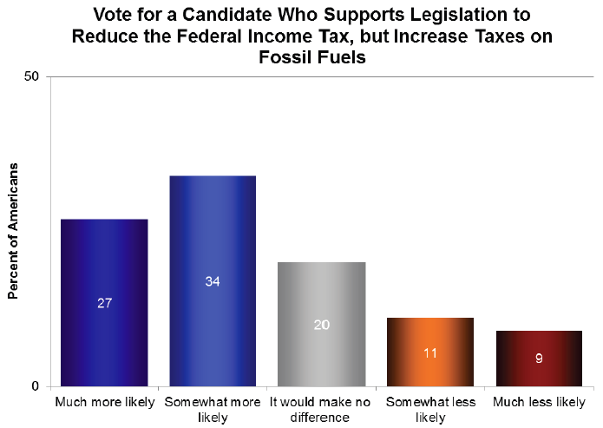
A way forward
Climate policy must be rooted in a domestic demand for emission reduction

Slide 11
A way forward -2
Unilateral climate policy is expensive, because domestic producers are put at a disadvantage
The UNFCCC establishes standards for emissions monitoring, and its annual meetings are suited for pledge and review
Trade organizations should play a greater role in international climate policy

Slide 12
A way forward -3
The costs of emission reduction vary widely between companies, between sectors, and between countries
The Kyoto Protocol establishes flexibility mechanisms, through which countries can invest in emission reduction elsewhere should that be cheaper than domestic emission reduction

Slide 14
A way forward -4
There is a revolution in energy
Climate policy should stop trying to create its own revolution, and ride the wave of the ongoing revolution instead
The market says shale gas. European politicians say wind, solar, nuclear. Austerity is putting an end to renewable subsidies. American shale is pushing down coal prices. The result is an increase in coal use in Europe, and higher emissions.

Slide 15
Wrap up
Climate change is a smallish problem with a simple solution
Forces conspire to complicate the solution and polarize the debate
Austerity and a new global scare are the best hopes for climate policy

